Slide 1
PREDICTION OF HOSPITAL STAY DURATION
GROUP 53
Venkata Nithya Ala (ala.v@northeastern.edu)
Prabhat Chanda (chanda.p@northeastern.edu)
Date: April 21, 2023

Slide 2
TABLE OF CONTENTS
Project Overview
Problem Setting
Problem Definition
Data Sources
Data Description
Data Exploration
Data Preprocessing
Data Visualization
Correlation and Association Analysis
Feature Engineering
Data Mining Models
Performance Evaluation and Insights
Project Results and Impact of Project Outcomes
Conclusion and Future Scope

Slide 3
PROJECT OVERVIEW
This project aims to predict the length of stay of a patient at the time of admission based on various factors to help hospitals optimize treatment plans, allocate resources efficiently, and improve patient experience.
PROBLEM SETTING
Healthcare organizations are under pressure to improve patient care and facilities. Leveraging healthcare analytics to measure metrics, such as duration of hospital stay, is crucial in providing improved experience to all patients.

Slide 4
PROBLEM DEFINITION
Hospitals are striving to allocate resources efficiently and meet the increasing demand for better healthcare. Accurately predicting a patient’s duration of stay can help hospitals manage resources and emergencies effectively.
DATA SOURCES
This project is based on the research paper “Analysis of length of hospital stay using electronic health records: A statistical and data mining approach”. The researchers made the dataset publicly available.

Slide 5
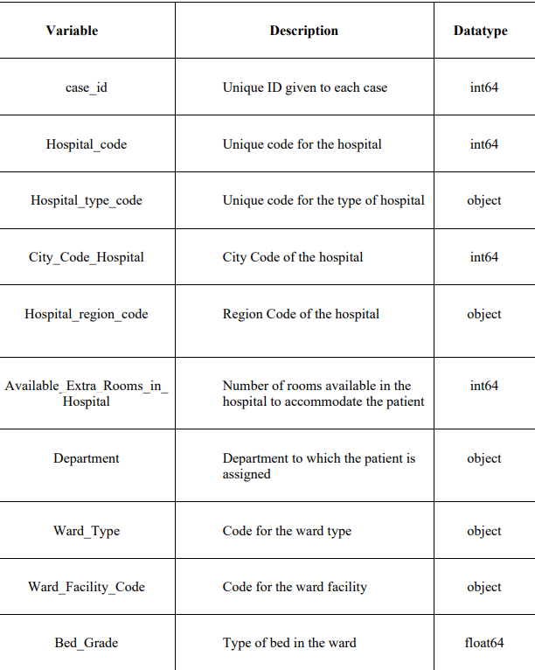
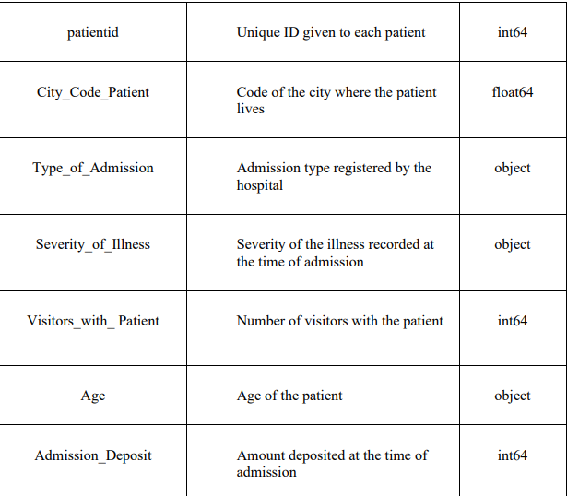
DATA DESCRIPTION
DATA DESCRIPTION

Slide 6
DATA EXPLORATION
Exploration of data revealed that there are 14 categorical predictors and 3 numerical predictors.
The target variable ‘Stay’ has 11 classes (0-10, 11-20, 21-30, 31-40, 41-50, 51-60, 61-70, 71-80, 81-90, 91-100, and more than 100 days).
DATA PREPROCESSING
Removing errors: It was observed that the category 11-20 was misrepresented as ‘Nov-20’ in the Age and Stay columns.
Missing values: The columns ‘Bed_Grade’ and ‘City_Code_Patient’ have missing values and have been imputed accordingly.

Slide 7
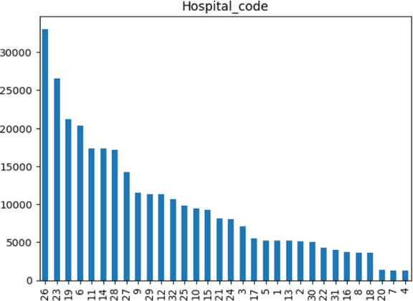
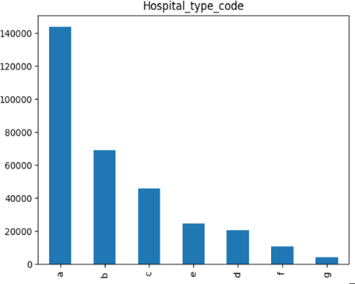
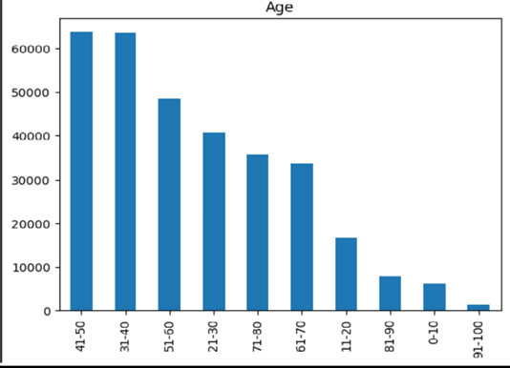
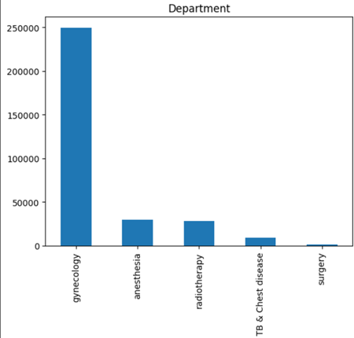
DATA VISUALIZATION

Slide 8
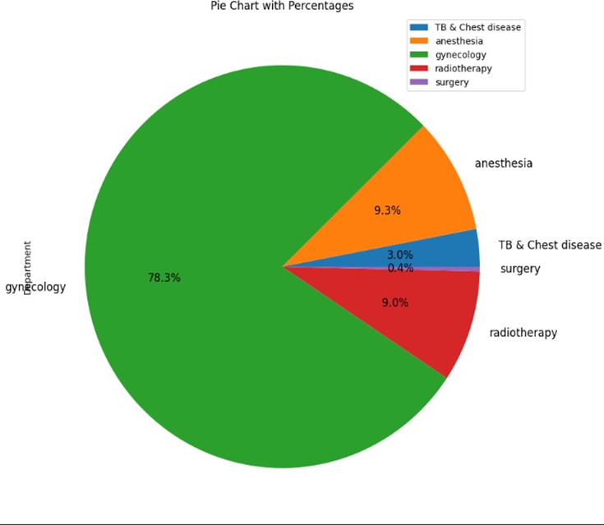
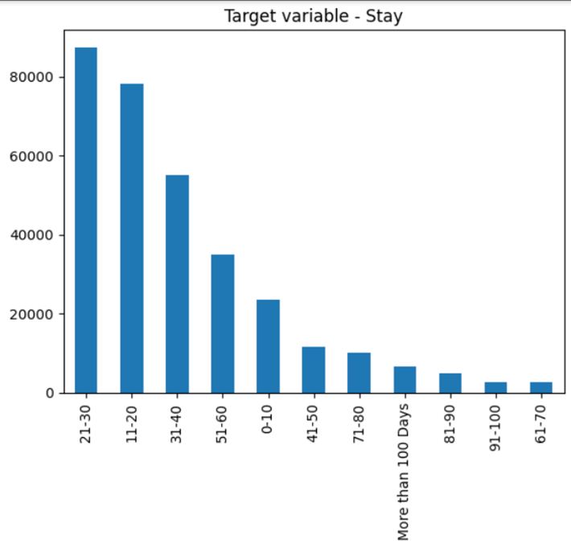
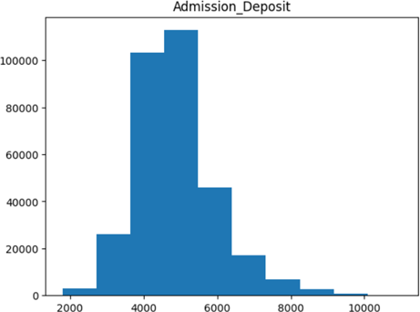

Slide 9
CORRELATION AND ASSOCIATION ANALYSIS
Since the response variable is categorical and ordered, Kendall Rank Correlation Coefficient (Kendall's Tau) and Spearman’s Rank Correlation Coefficient (Spearman’s Rho) are used to find the association between variables.
KENDALL’S TAU
The association between ordered categorical predictors and the response variable (ordered) is found using Kendall’s Tau.
SPEARMAN’S RHO
Spearman’s Rho is used to find the association between all unordered categorical variables and the response variable. It is also used to find the association between all input variables.
IT IS CONCLUDED THAT DIMENSION REDUCTION IS NOT NECESSARY

Slide 10
FEATURE ENGINEERING
To account for multiple records for each patient in the dataset, 3 new columns have been created.
count_of_admits_of_a_patient
count_of_admits_of_a_patient_in_ hospitalregion
count_of_wards_allocated_to_patient
SAMPLING THE DATA FOR TRAINING AND TESTING
Training data: Since the class distribution is highly imbalanced, to ensure that training data is balanced, 1000 records are taken from each class.
Test data: A stratified sample consisting of 4000 records is taken.

Slide 11
DATA MINING MODELS
The following data mining models have been considered for predicting the length of target variable ‘Stay’.
Logistic regression
K-Nearest Neighbors (KNN)
Decision Trees
Random Forests
Naive Bayes
XGBoost
The above models handle both categorical and numerical input variables and can be used for multiclass classification.

Slide 12
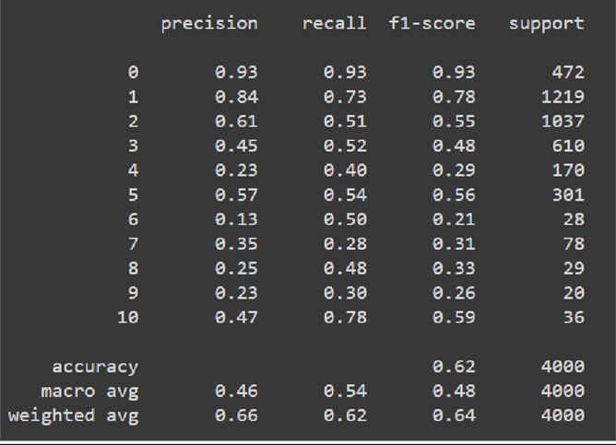
LOGISTIC REGRESSION MODEL
The target variable is categorical with 11 classes. A multinomial logistic regression model has to be used for multiclass problems.
Advantages:
Handles both linear and non-linear relationships
Easy to improve generalization
Disadvantages:
Logistic regression is only efficient when the number of classes is relatively small and the input features are not too complex or high-dimensional.

Slide 13
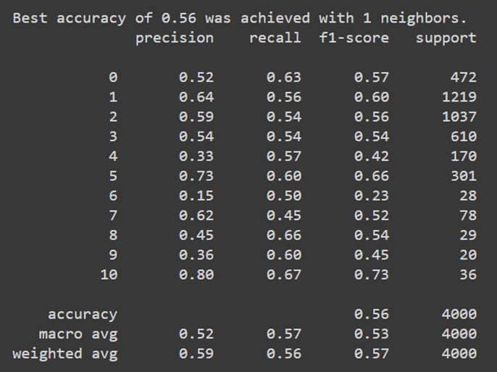
K-NEAREST NEIGHBORS CLASSIFIER
K-Nearest Neighbors (KNN) is useful for predicting the length of stay of a patient based on the features of other patients who are similar to the new patient.
Advantages:
No training required
Handles both types of data
Disadvantages:
Computationally expensive
Choice of K value is key
Sensitive to noise

Slide 14
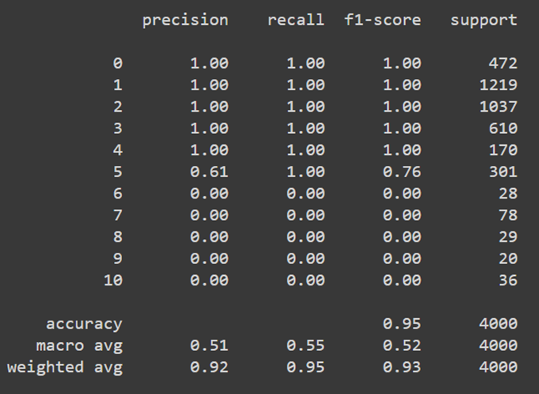
DECISION TREE CLASSIFIER
Decision tree classification is a popularly used algorithm in predictive analysis. A decision tree classifier maps a patient to a duration of hospital stay based on the patient’s features.
Advantages:
Feature importance
Handles both types of data
Handles missing values
Disadvantages:
Bias towards features with many
levels
Unstable

Slide 15
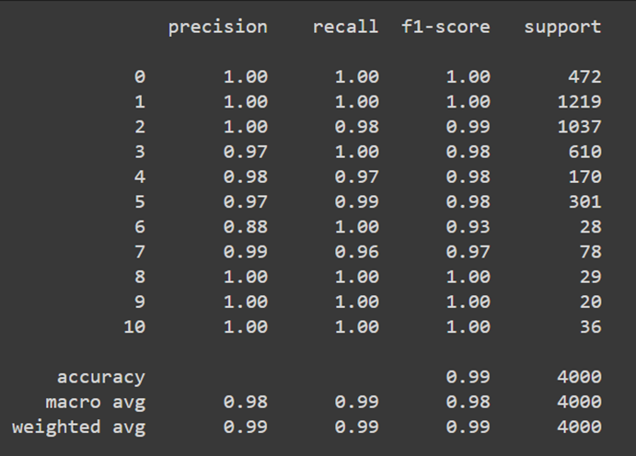
RANDOM FOREST CLASSIFIER
Random Forest is a machine learning algorithm that is commonly used in predictive analysis. It is a type of ensemble learning algorithm that combines multiple decision trees to make a prediction.
Advantages:
Non-parametric
Robust to overfitting
Disadvantages:
Computationally expensive
Tuning hyperparameters

Slide 16
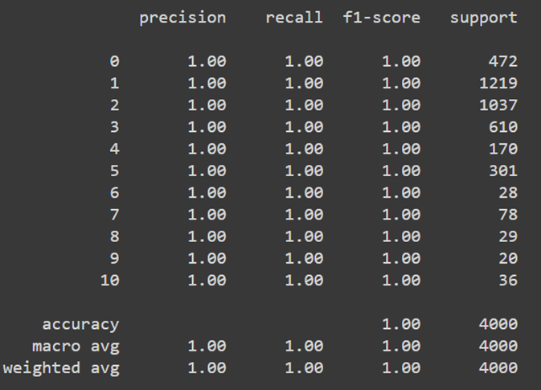
NAIVE BAYES CLASSIFIER
Naïve Bayes is a classification technique that works on the principle of Bayes theorem with an assumption of independence among the variables. Naïve Bayes is suitable for multi-level classification.
Advantages:
Fast and efficient
Handles both types of data
Disadvantages:
Naive assumption
Limited ability to handle
imbalanced data

Slide 17
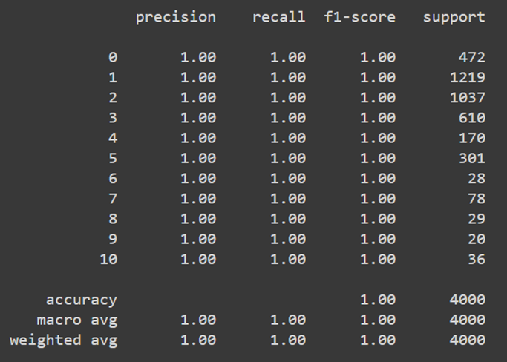
XGBOOST CLASSIFIER
Extreme Gradient Boosting is a sequential technique that works on the principle of an ensemble. Tree ensemble is a set of classification and regression trees. Trees are grown one after another to reduce the misclassification rate.
Advantages:
Regularisation
Feature importance
Disadvantages:
Complexity
Black Box Model

Slide 18
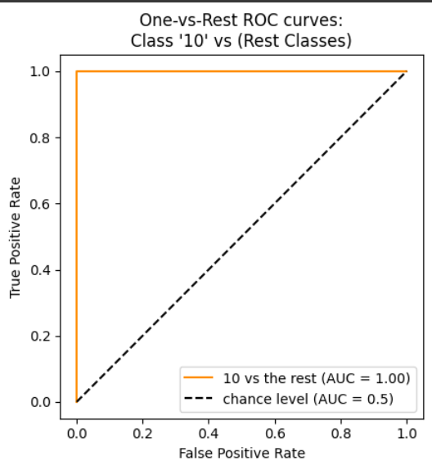
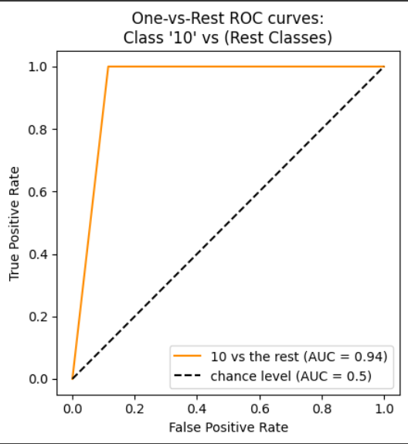
PERFORMANCE EVALUATION AND INSIGHTS
The logistic regression model exhibits moderate performance, while the KNN classifier exhibits poor performance.
The decision tree classifier and random forest classifier exhibit excellent performance yielding 95% and 99% accuracy respectively, along with high AUC from ROC curve.
Decision Tree
Random Forest

Slide 19
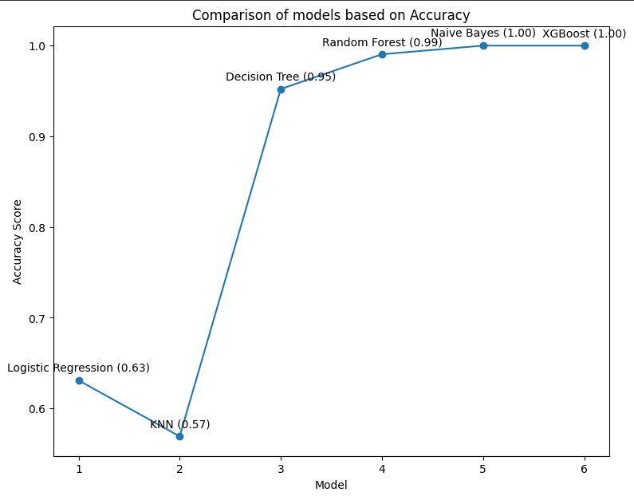
PERFORMANCE EVALUATION AND INSIGHTS
Naive bayes classifier fails to detect the relationship among variables in the training data and leads to overfitting by just memorizing the data.
Complex models like XGBoost also lead to overfitting, hence are not useful.

Slide 20
PROJECT RESULTS
Decision tree yields 95% accuracy and a F1 score of 93%. Random forest exhibits the highest accuracy of 99%, high precision (98%) and high F-1 score (99%).
While a decision tree can be used for the prediction of hospital stay duration, a random forest classifier yields best results.
IMPACT OF THE PROJECT OUTCOMES
The implementation of this highly accurate predictive model can significantly impact healthcare by enabling hospitals to manage patient flow, allocate resources efficiently, and reduce costs. Hospitals can plan and prepare for patient admissions and discharges, thereby improving patient experience.

Slide 21
CONCLUSION AND FUTURE SCOPE
A random forest classifier accurately predicts the duration of hospital stay of patients at the time of admission.
Hospitals can implement this model to manage the resources effectively, reduce costs and improve patient experience.
Furthermore, the model can be improvised to predict a definite number for hospital stay instead of a category representing a range of days.

Slide 22
REFERENCES
Hyunyoung Baek, Minsu Cho, Seok Kim , Hee Hwang, Minseok Song, Sooyoung Yoo, Analysis of length of hospital stay using electronic health records: A statistical and data mining approach. https://pubmed.ncbi.nlm.nih.gov/29652932/

